Slide 1
Software Engineering (SE)
By Sandia Kumari
Software Testing
Lecture 4
Notes:
9:30-10:10
11:00-11:40

Slide 2
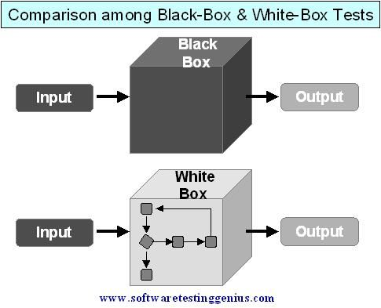

Slide 3
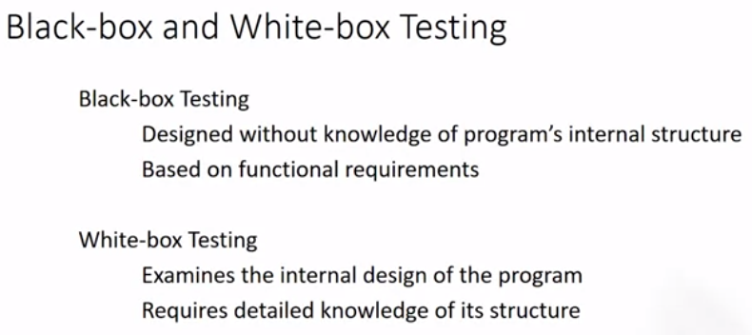
Testing Strategies
Notes:
Black box is mostly done by Tester and white box by developer

Slide 4
Test Case Design Strategies
Black-box or behavioral testing (knowing the specified function a product is to perform and demonstrating correct operation based solely on its specification without regard for its internal logic)
White-box or glass-box testing (knowing the internal workings of a product, tests are performed to check the workings of all independent logic paths)

Slide 5
Unit Testing and Component Testing
Module
Unit
Unit
Unit
Unit
Unit
Unit
Unit
System
Subsystems
Component
Module
Module
Subsystems
Notes:
Component/subsystem

Slide 6
Unit: Smallest useful piece of software, and often has the smallest tests. Often (but not always), these are “sanity checks” to make sure code changes haven’t broken anything obvious.
Component: Test the behavior of a class (or groups of related classes) on a whole. Should cover all methods / properties / etc., and should cover as many “valid” inputs as possible.
System/Integration: Test behavior of components interacting with each other. These tests should cover more “unusual” scenarios, such as invalid inputs.

Slide 7
Component testing
Software components are often composite components that are made up of several interacting objects.
For example, in the weather station system, the reconfiguration component includes objects that deal with each aspect of the reconfiguration.
You access the functionality of these objects through the defined component interface.
Testing composite components should therefore focus on showing that the component interface behaves according to its specification.
You can assume that unit tests on the individual objects within the component have been completed.

Slide 8
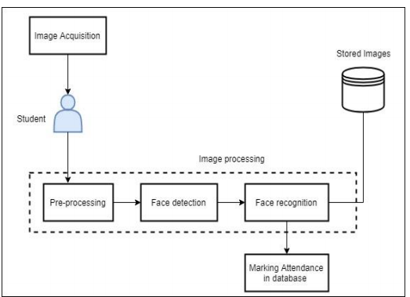
Components of Face Recognition Attendance System

Slide 9
Interface testing
Assume that components A, B, and C have been integrated to create a larger component or subsystem. The test cases are not applied to the individual components but rather to the interface of the composite component created by combining these components.

Slide 10
Interface testing
There are different types of interface between program components and, consequently, different types of interface error that can occur:
Objectives are to detect faults due to interface errors or invalid assumptions about interfaces.
Interface types
Parameter interfaces Data passed from one method or procedure of component to another.
Shared memory interfaces Block of memory is shared between procedures or functions of components
Procedural interfaces Sub-system encapsulates a set of procedures to be called by other sub-systems.
Message passing interfaces Sub-systems request services from other sub-systems

Slide 11
Interface errors
Interface misuse
A calling component calls another component and makes an error in its use of its interface e.g. parameters in the wrong order or wrong type or wrong number of parameters passed.
Interface misunderstanding
A calling component embeds assumptions about the behaviour of the called component which are incorrect. E.g. A binary search method may be called with a parameter that is unordered array. The search would then fail.
Timing errors
These occur in real-time systems. The called and the calling component operate at different speeds and out-of-date information is accessed.
Notes:
Database locking race condition

Slide 12
Interface testing guidelines
Design tests so that parameters to a called procedure are at the extreme ends of their ranges.
Always test pointer parameters with null pointers.
Design tests which cause the component to fail.
Use stress testing in message passing systems.
In shared memory systems, vary the order in which components are activated.

Slide 13
System Testing
System testing during development involves integrating components to create a version of the system and then testing the integrated system
System
Subsystems
Subsystems

Slide 14
System testing
The focus in system testing is testing the interactions between components.
System testing checks that components are compatible, interact correctly and transfer the right data at the right time across their interfaces.
System testing tests the emergent behavior of a system.

Slide 15
System and component testing
It obviously overlaps with component testing, but there are two important differences
During system testing, reusable components that have been separately developed and off-the-shelf systems may be integrated with newly developed components. The complete system is then tested.
Components developed by different team members or sub-teams may be integrated at this stage. System testing is a collective rather than an individual process.
In some companies, system testing may involve a separate testing team with no involvement from designers and programmers.
Notes:
Off-the-shelf software is software that is ready-made and available to lots of people. You usually pay a license fee to use it, e.g. Microsoft Office

Slide 16
System Testing
All systems have emergent behavior. This means that some system functionality and characteristics only become obvious when you put the components together. This may be planned emergent behavior, which has to be tested.
For example, you may integrate an authentication component with a component that updates the system database. You then have a system feature that restricts information updating to authorized users. Sometimes, however, the emergent behavior is unplanned and unwanted. You have to develop tests that check that the system is only doing what it is supposed to do.

Slide 17
System testing should focus on testing the interactions between the components and objects that make up a system
This interaction testing should discover those component bugs that are only revealed when a component is used by other components in the system.
Interaction testing also helps find misunderstandings, made by component developers, about other components in the system
Because of its focus on interactions, use case-based testing is an effective approach to system testing

Slide 18
Use-case testing
The use-cases developed to identify system interactions can be used as a basis for system testing.
Each use case usually involves several system components so testing the use case forces these interactions to occur.
The sequence diagrams associated with the use case documents the components and interactions that are being tested.

Slide 19
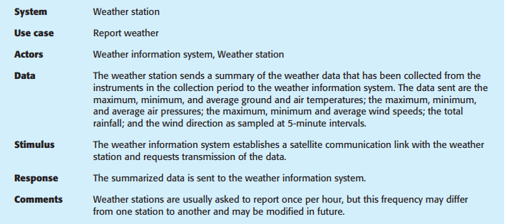
Therefore issuing a request for a report will result in the execution of the following thread of methods:
SatComms:request → WeatherStation:reportWeather → Commslink:Get(summary) → WeatherData:summarize

Slide 20
Collect weather data sequence chart

Slide 21
Test cases derived from sequence diagram
The sequence diagram helps you design the specific test cases that you need, as it shows what inputs are required and what outputs are created:
An input of a request for a report should have an associated acknowledgment. A report should ultimately be returned from the request. During testing, you should create summarized data that can be used to check that the report is correctly organized.
2. An input request for a report to WeatherStation results in a summarized report being generated. You can test this in isolation by creating raw data corresponding to the summary that you have prepared for the test of SatComms and checking that the WeatherStation object correctly produces this summary. This raw data is also used to test the WeatherData object

Slide 22
Of course, I have simplified the sequence diagram in Figure so that it does not show exceptions. A complete use case/scenario test must take these exceptions into account and ensure that they are correctly handled.
For most systems, it is difficult to know how much system testing is essential and when you should stop testing. Exhaustive testing, where every possible program execution sequence is tested, is impossible
Testing, therefore, has to be based on a subset of possible test cases. Ideally, software companies should have policies for choosing this subset.
Notes:
Exhaustive testing is type of software testing approach where all the possible data combinations are used for testing

Slide 23
Testing policies
Exhaustive system testing is impossible so testing policies which define the required system test coverage may be developed.
Examples of testing policies:
All system functions that are accessed through menus should be tested.
Combinations of functions (e.g. text formatting) that are accessed through the same menu must be tested.
Where user input is provided, all functions must be tested with both correct and incorrect input.

